Slide 1
Team NVR Stock Analysis and Trading Model
Khajan Joshi Kshitija Suryavanshi
Saad Ghojaria
Sushmita Maity
Kunwar Rajesh Chopra

Slide 2
Introduction
Homebuilding & Mortgage banking, Fortune 500
NVR has a market cap of $13.71 Billion, (1120th most valuable company)
Earnings growth( Historical EPS rate of 20.6%), predicted rise 68.4%. (Market average: 46.8%)
Asset Utilization ratio (1.56). (Market average : 1)
Sales growth predicted to be 19.7%. (Above market average 12.8%)

Slide 3
Objectives
NVR Stock and comparison with competitors from 2017 to 2022
Study of various models with dataset of NVR stocks (3 Factor Fama French, CAPM)
Kalman & Garch models for price prediction
Candidate Models to predict future values (Auto Arima, XGBoost, LSTM)
Generating trading signals using model methods (3MA & MACD)
Portfolio, Conclusion

Slide 4
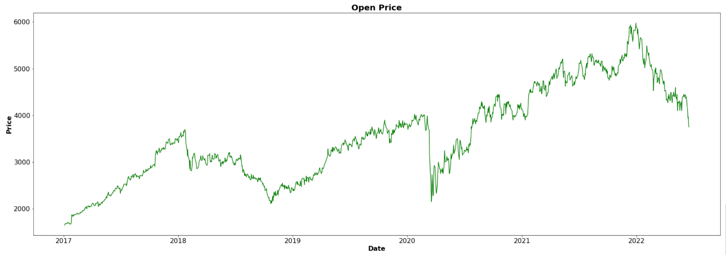
NVR Open Price Visualisation
NVR Open price visualisation from 2017 to current year:
The opening price is the price at which a security first trades when an exchange opens for the day.
The prices increased from $1650 to a maximum of $5977 in last 5 years.

Slide 5
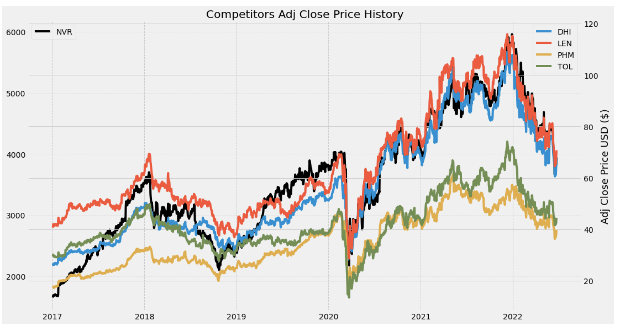
Close Price History
NVR (in black) in the past 5 years, has a Beta of 0.97, which makes it follow the market movement quite closely
In comparison to it’s competitors, since 2017, NVR has had a higher increase in the stock price
The stock has generated some opportunities of buying and selling by looking at the historic stock price movement
We have done further analysis to generate trading signals for these market movements using technical analysis such as RSI and multiple moving average techniques (3MA,MACD,etc.)

Slide 6
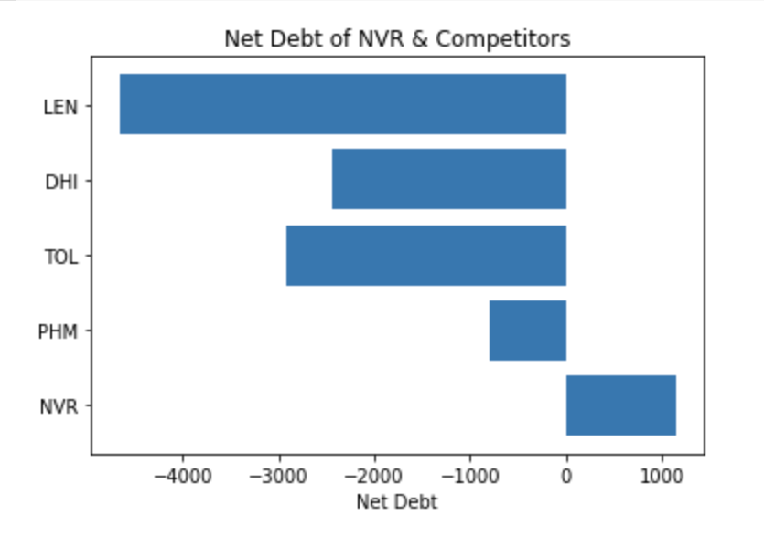
Net Debt Comparison of NVR and competitors
Net debt is a liquidity metric used to determine how well a company can pay all of its debts if they were due immediately.
Net debt shows how much debt a company has on its balance sheet compared to its liquid assets.
Net debt of NVR and its competitors show, only NVR has positive liquid assets.NVR is in the housing industry but has a very different business model compared to it’s competitors
They don’t buy the land they build homes on, but instead buy options and pay only 10% of the land’s value, this helps make them debt free
In comparison to their competitors, they have net cash, which they use to continuously grow their business
Values in Million $

Slide 7
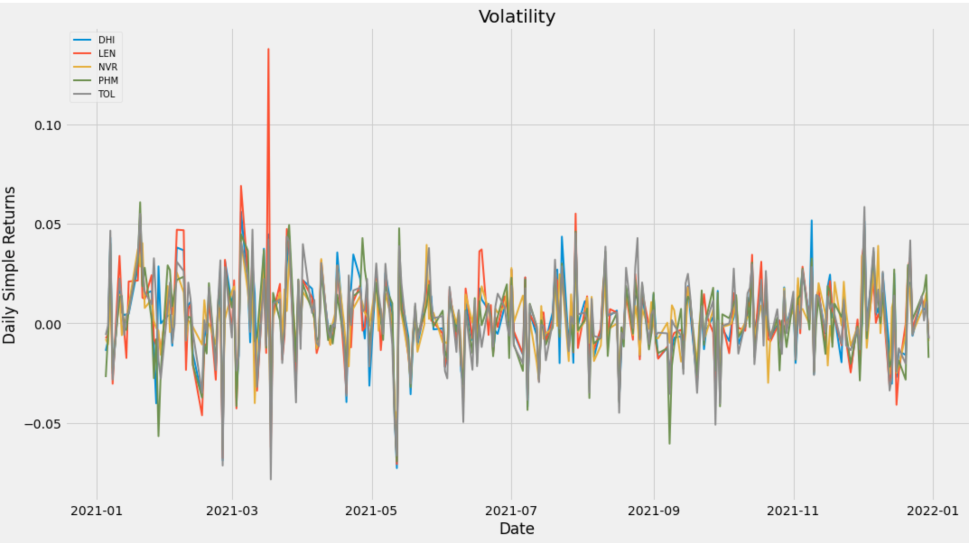
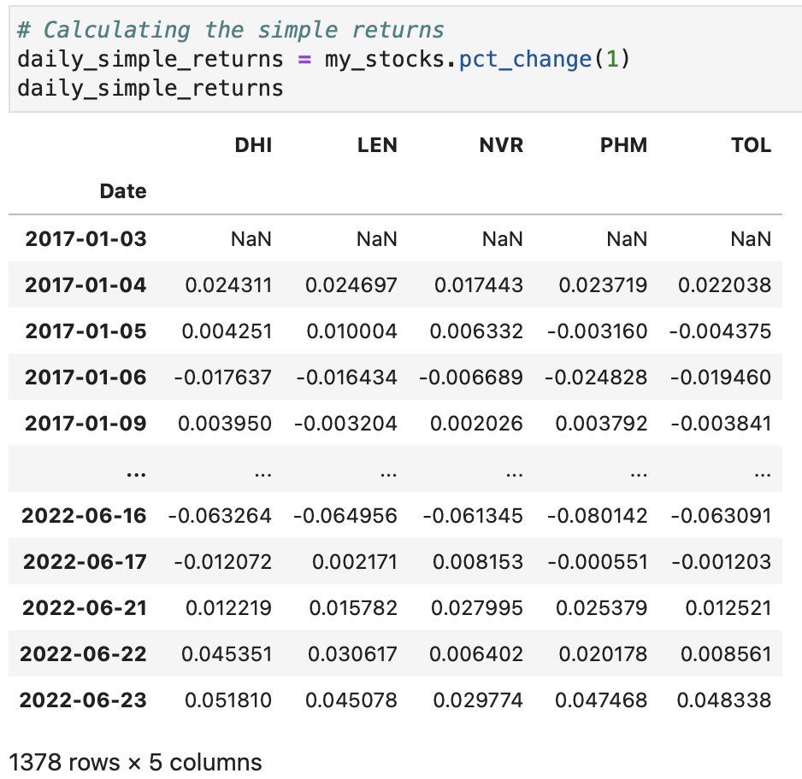
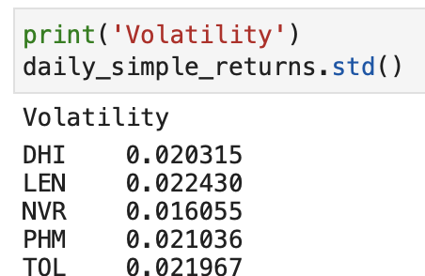
Volatility Comparison
Calculating the daily simple returns
Finding correlation and covariance of daily simple returns.
Variance, volatility, risk and return are directly related.
Higher the variance, higher the volatility, higher the risk, higher the return
Last 5 years show that NVR has the least volatility among its other 4 competitors.
TOL> LEN> PHM> DHI> NVR

Slide 8
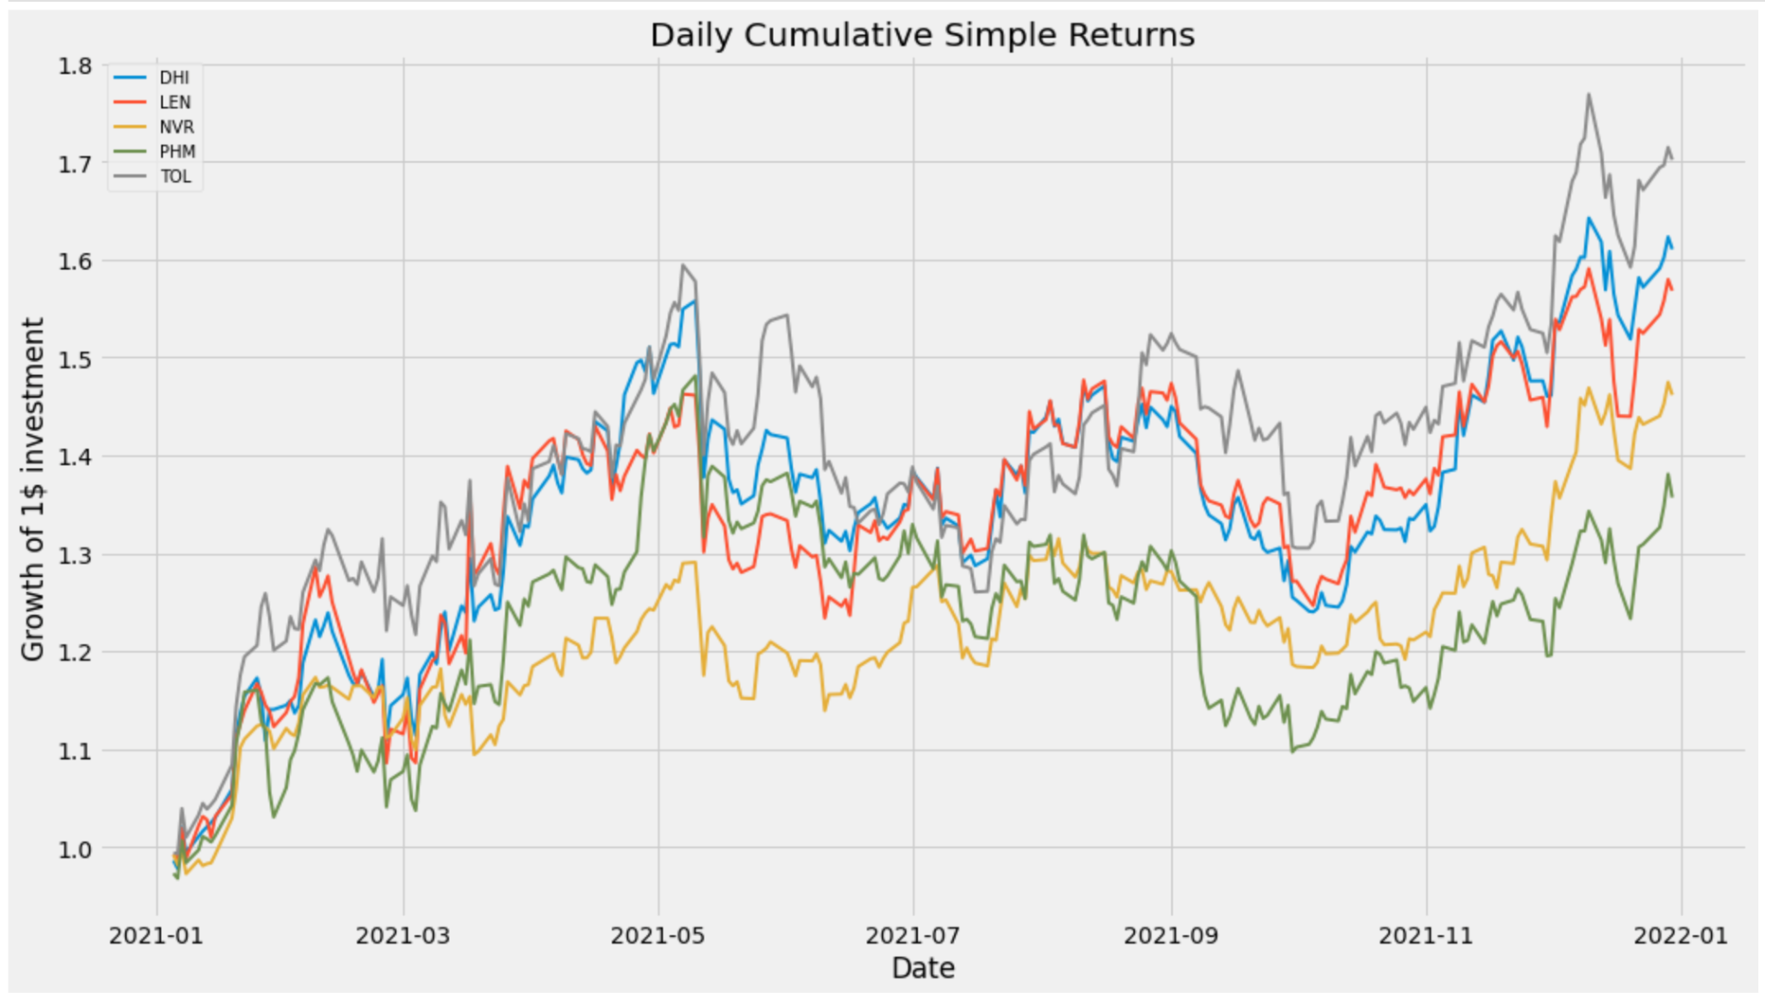
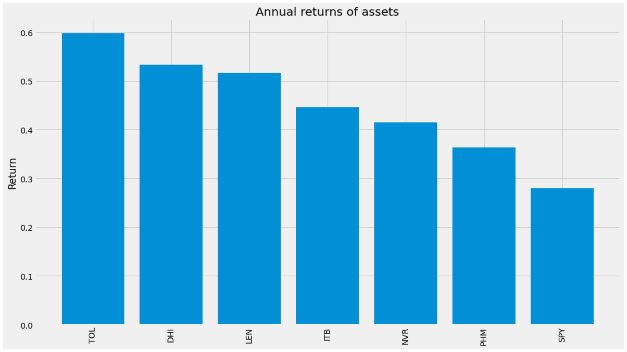
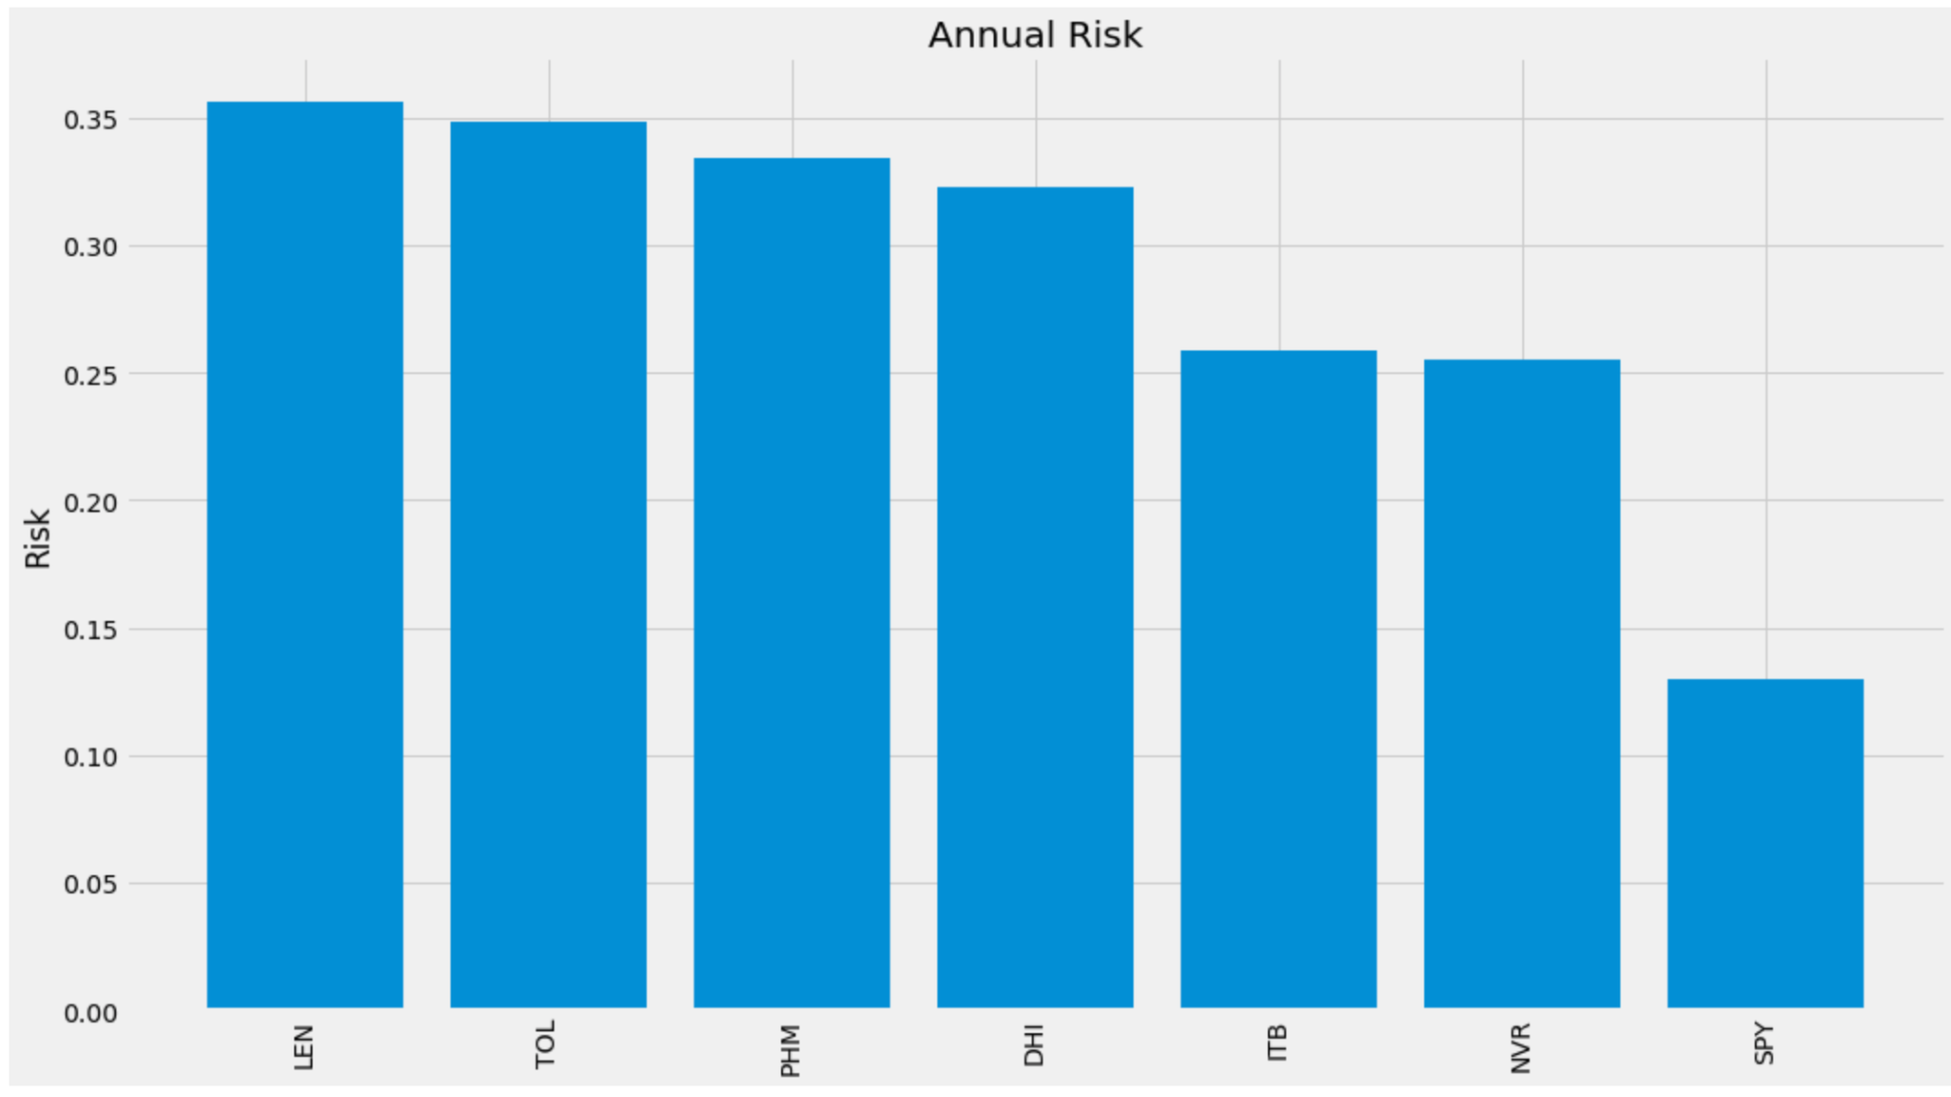
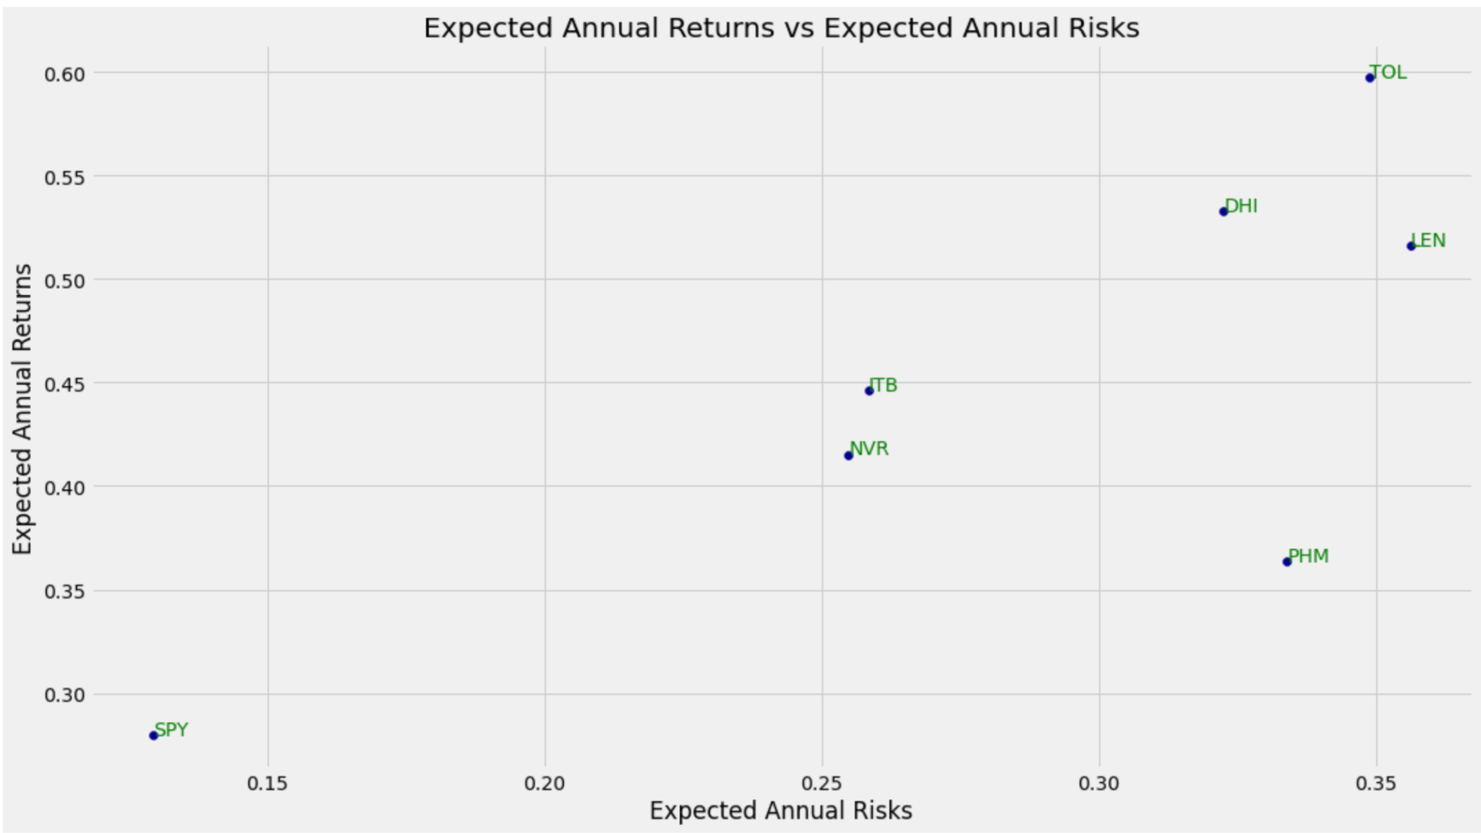
Daily Simple returns of NVR and competitors

Slide 9
Feature Selection
CAPM MODEL
3 FACTOR FAMA FRENCH MODEL
ADS FEATURES INTEGRATED

Slide 10
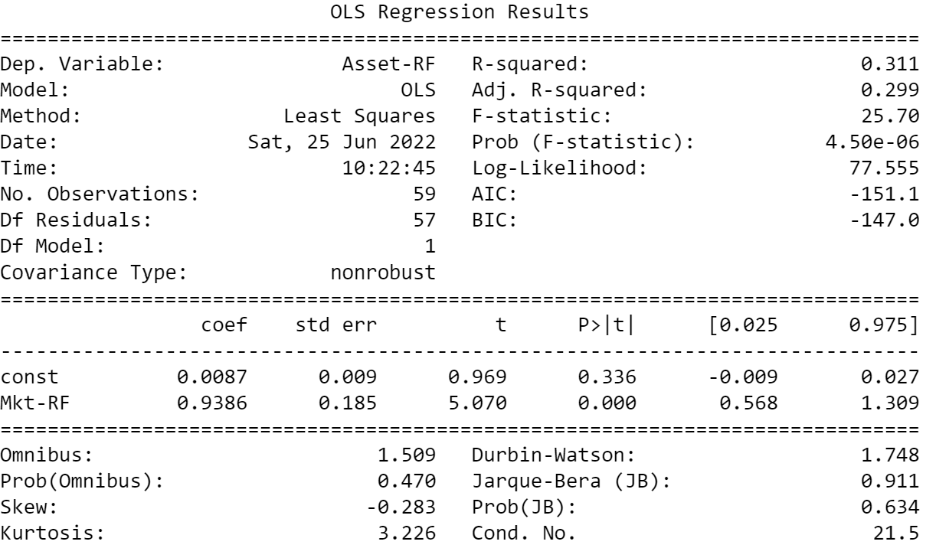
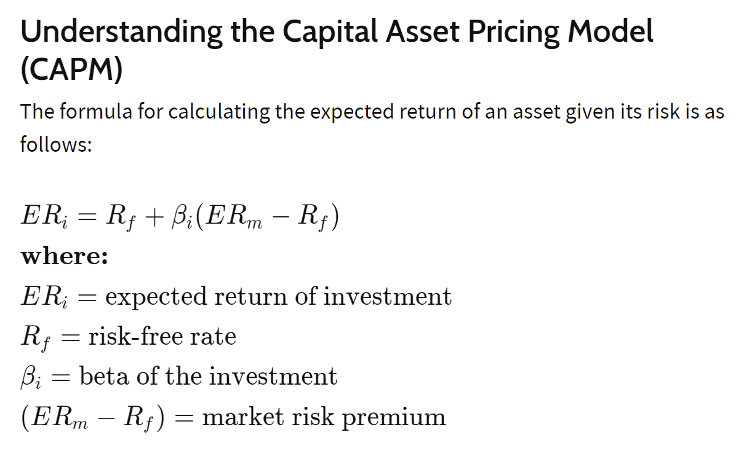
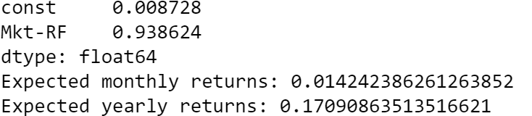
CAPM Model
Used For
1.Pricing risky securities
2.Get expected returns for assets given the risk and cost of capital.

Slide 11
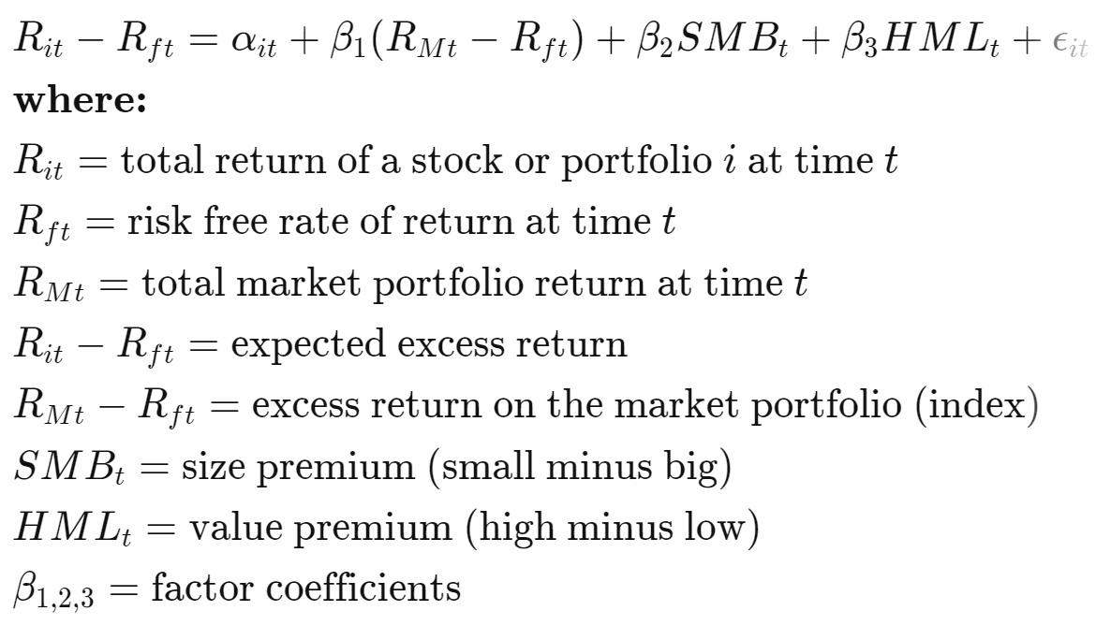
3 Factor Fama French
Factors used are:
Small minus big (SMB)
High minus low (HML)
Return less the risk-free rate of return
Factors driving expected returns:
Sensitivity to the market
Sensitivity to size
Sensitivity to value stocks

Slide 12
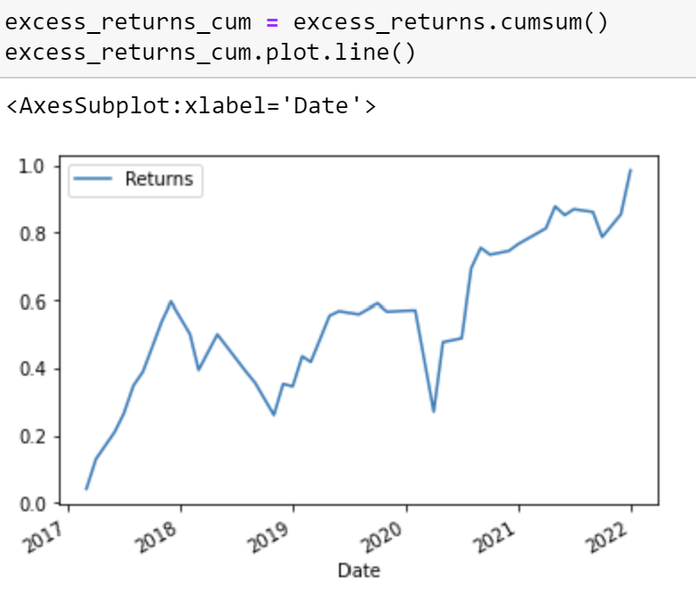
Excess Monthly Returns cumulative year wise

Slide 13
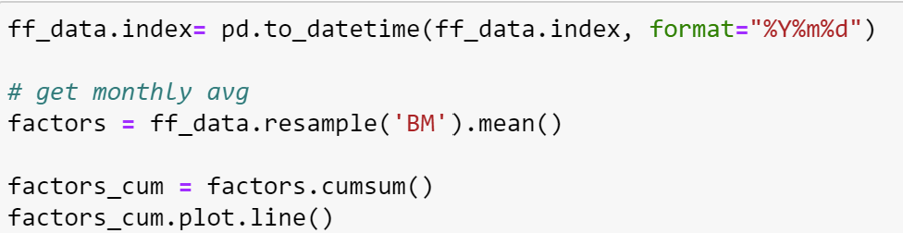
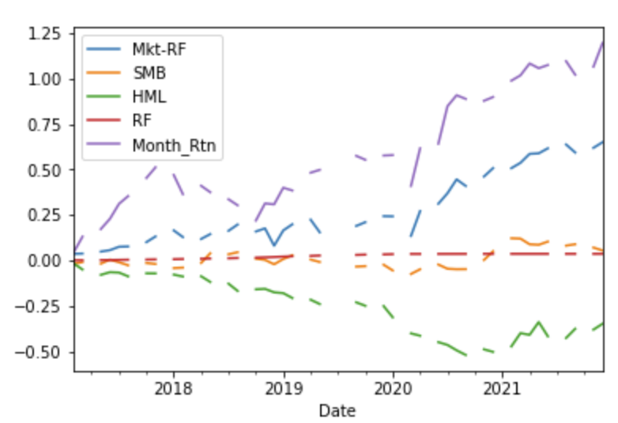
Monthly Average Cumulative

Slide 14
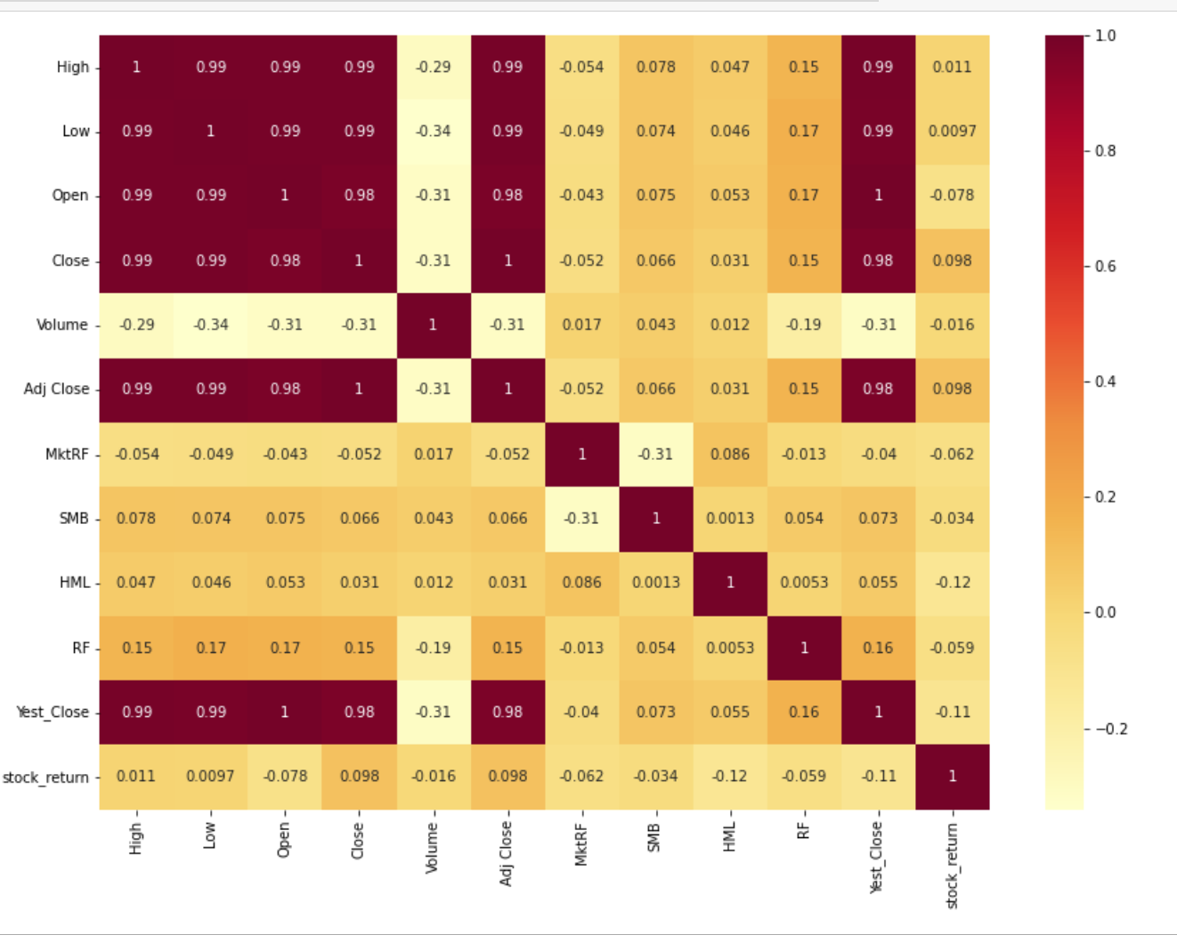
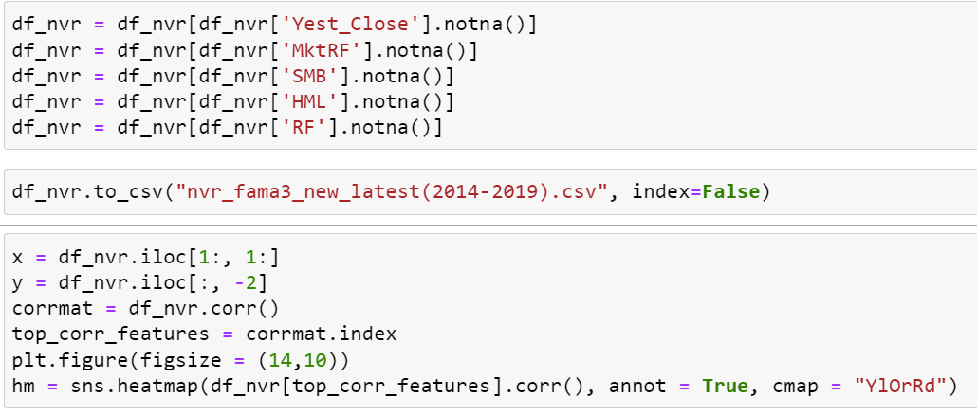
Heatmap for Feature Selection

Slide 15
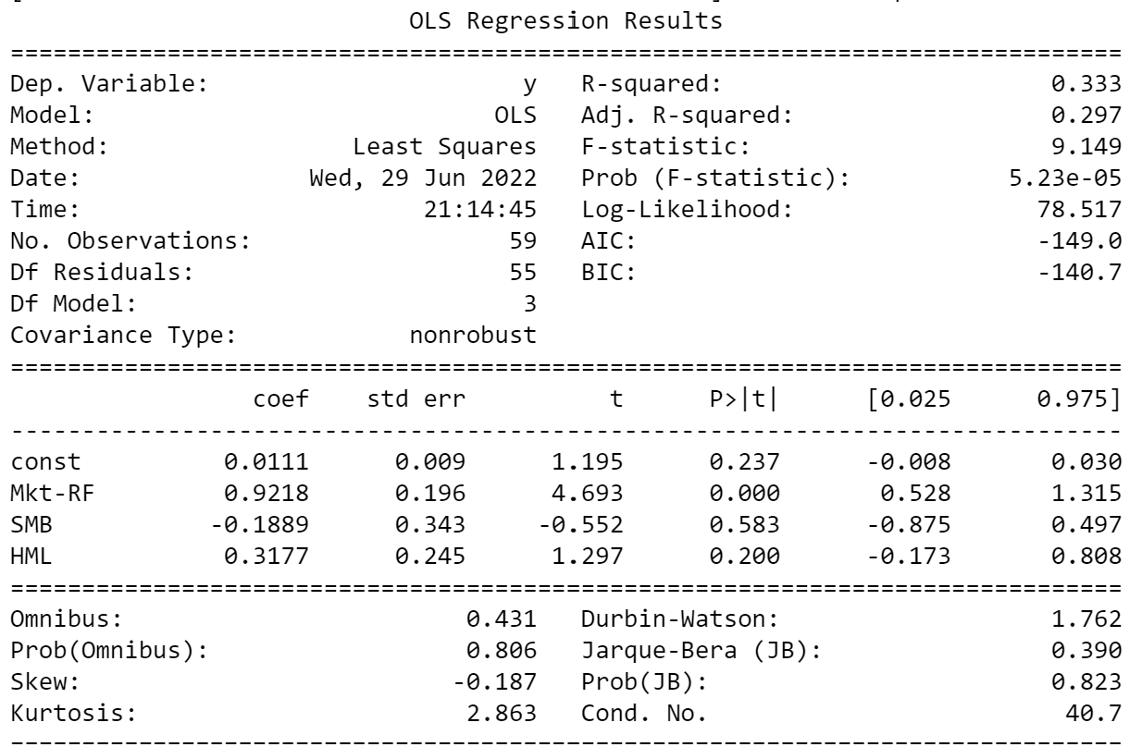
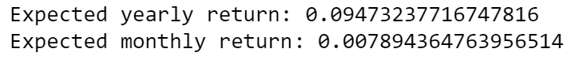
3 Factor Model Results
Coefficients:
Alpha- 0.011
Market Return - 0.9218
SMB - -0.1889
HML - 0.3177
Expected Return: 0.095

Slide 16
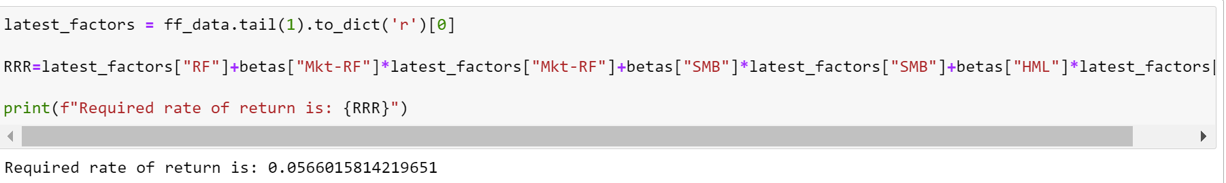
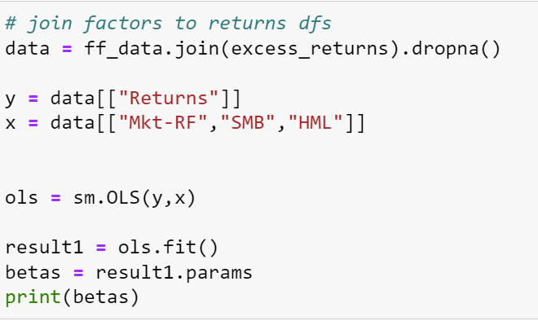
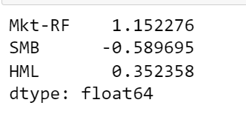
3 Factor
Required Rate of Return
Values of Beta Coefficients (Sensitivity)

Slide 17
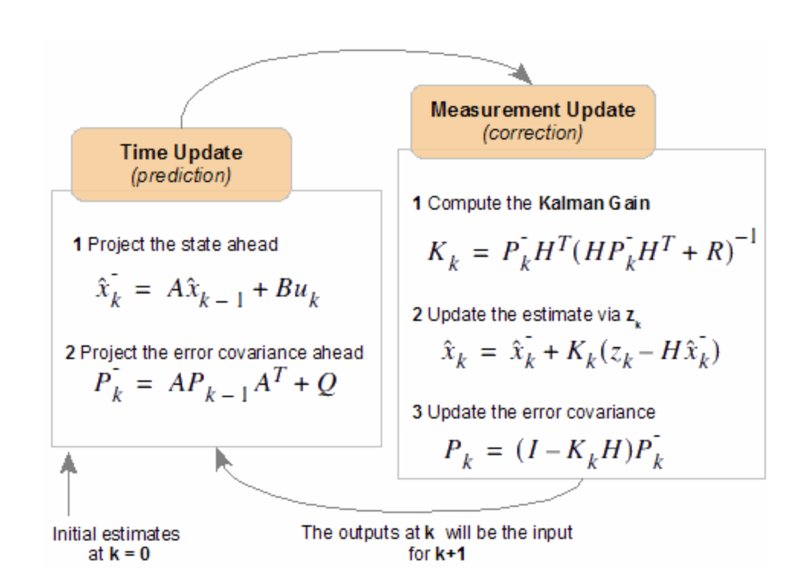
Kalman Filter
Provides estimates of some unknown variables given the measurements observed over time
Time Update (prediction) and Measurement Update (correction) are applied at each kth state.
Iterated such that previous estimates will be the input for the current state.

Slide 18
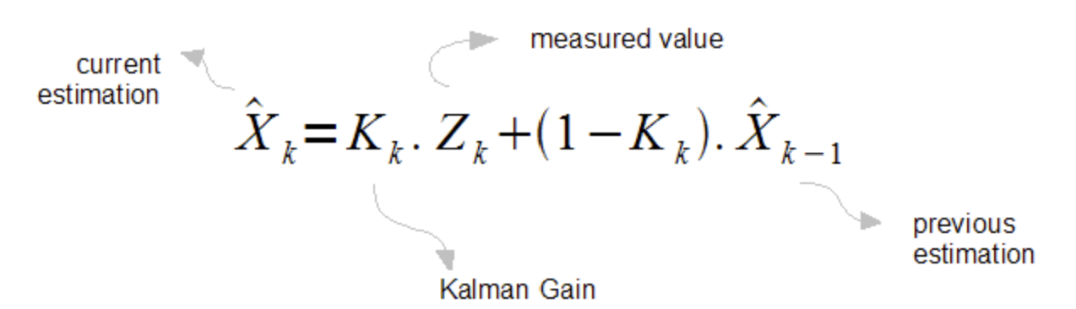
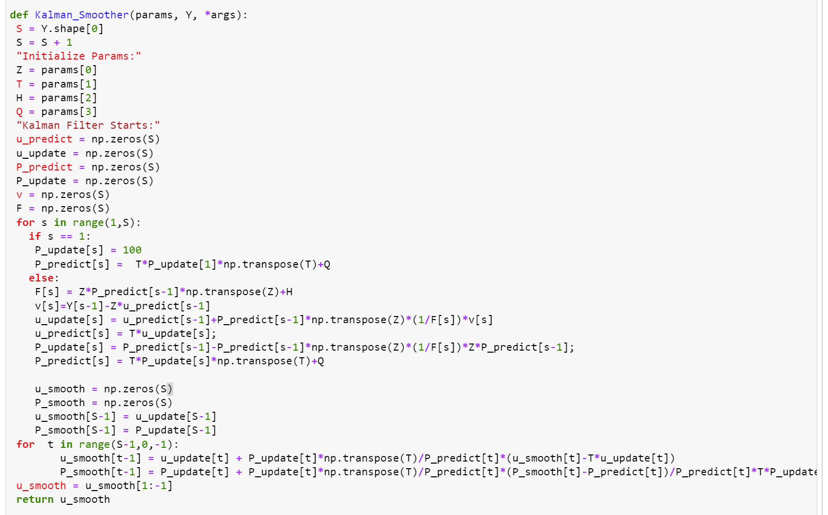
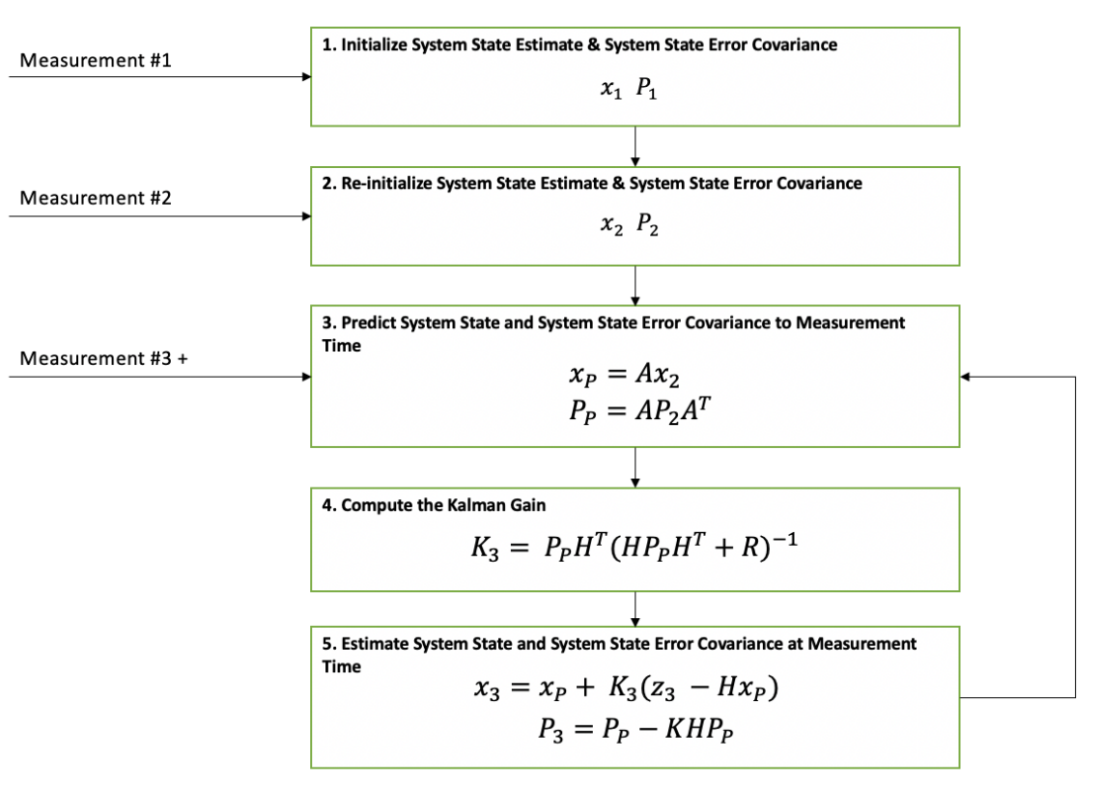

Slide 19
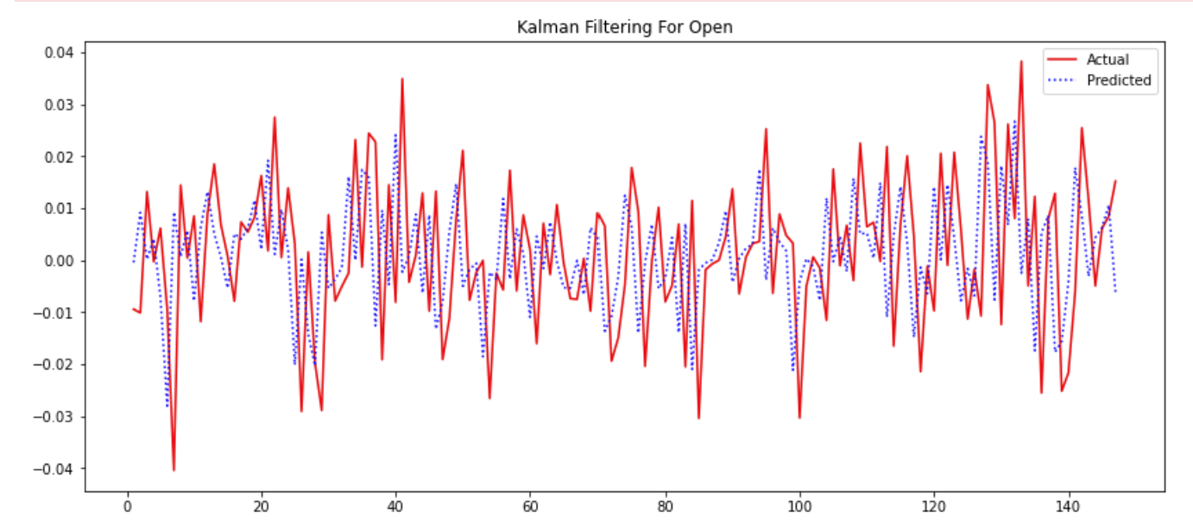
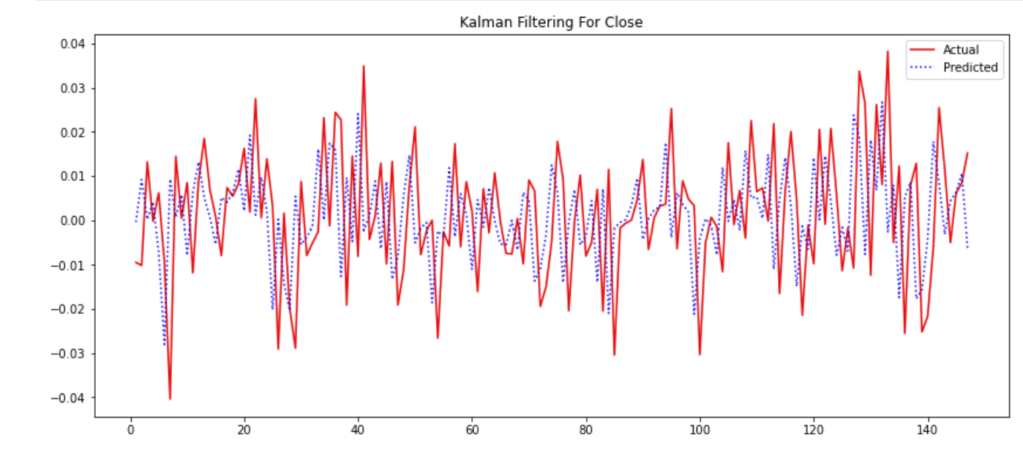
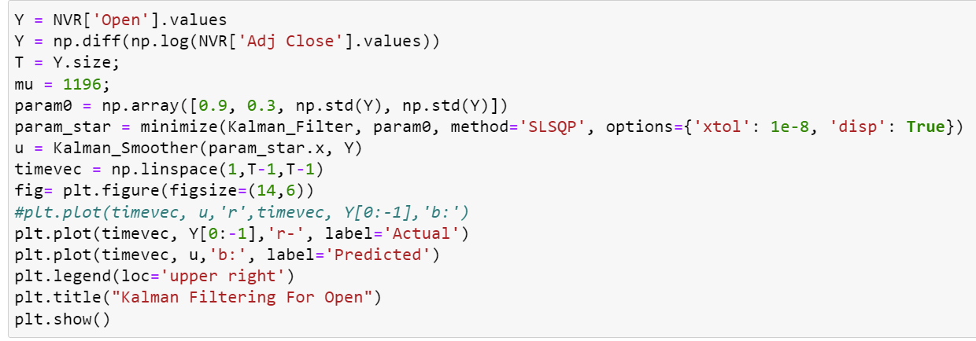
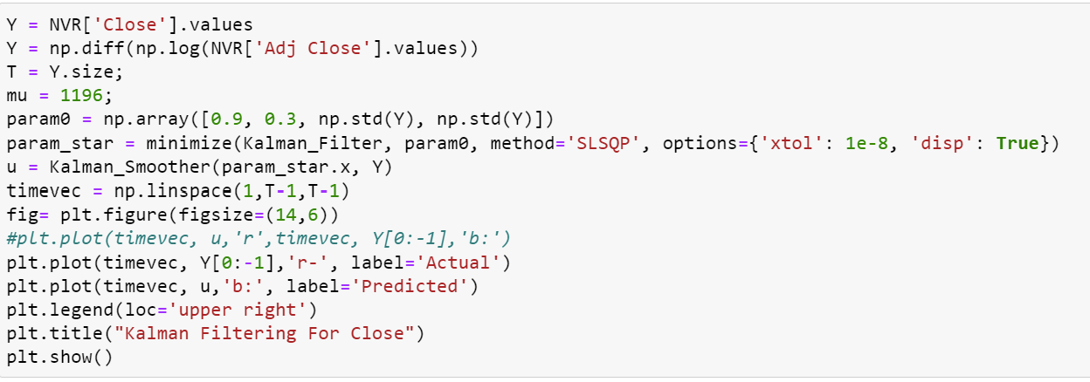

Slide 20
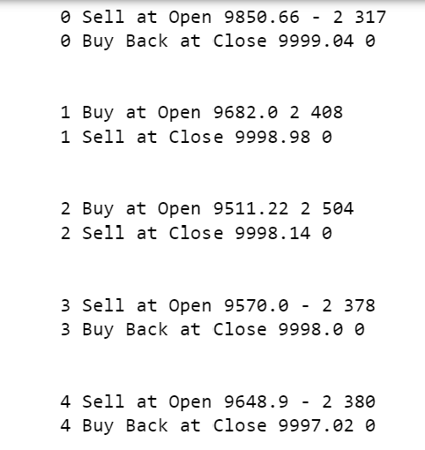
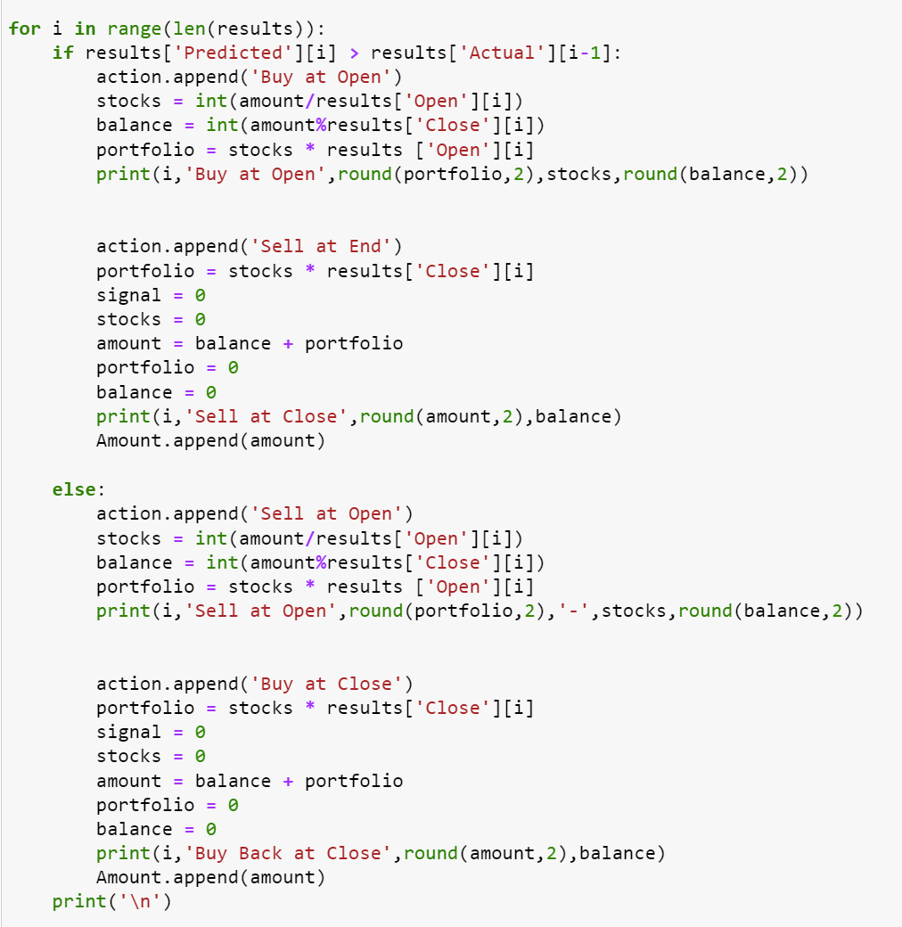
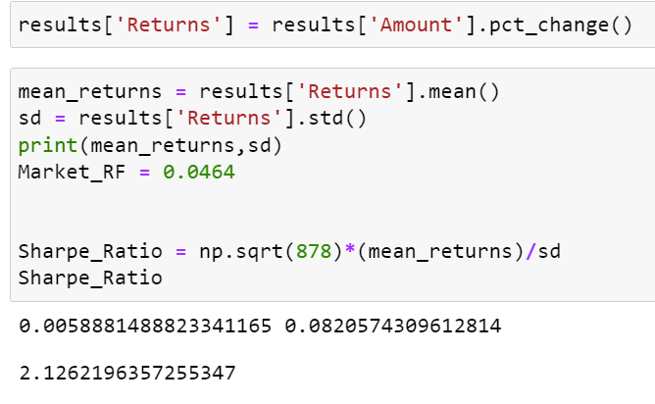
Trading Signals and Model Results
RMSE: 0.17

Slide 21
GARCH Filter
Generalized AutoRegressive Conditional Heteroskedasticity (GARCH) is a statistical model used in analyzing time-series data where the variance error is believed to be serially autocorrelated.
GARCH is appropriate for time series data where the variance of the error term is serially autocorrelated following an autoregressive moving average process.
GARCH is useful to assess risk and expected returns for assets that exhibit clustered periods of volatility in returns.
GARCH models describe financial markets in which volatility can change, becoming more volatile during periods of financial crises or world events and less volatile during periods of relative calm and steady economic growth. On a plot of returns, for example, stock returns may look relatively uniform for the years leading up to a financial crisis such as that of 2007.

Slide 22
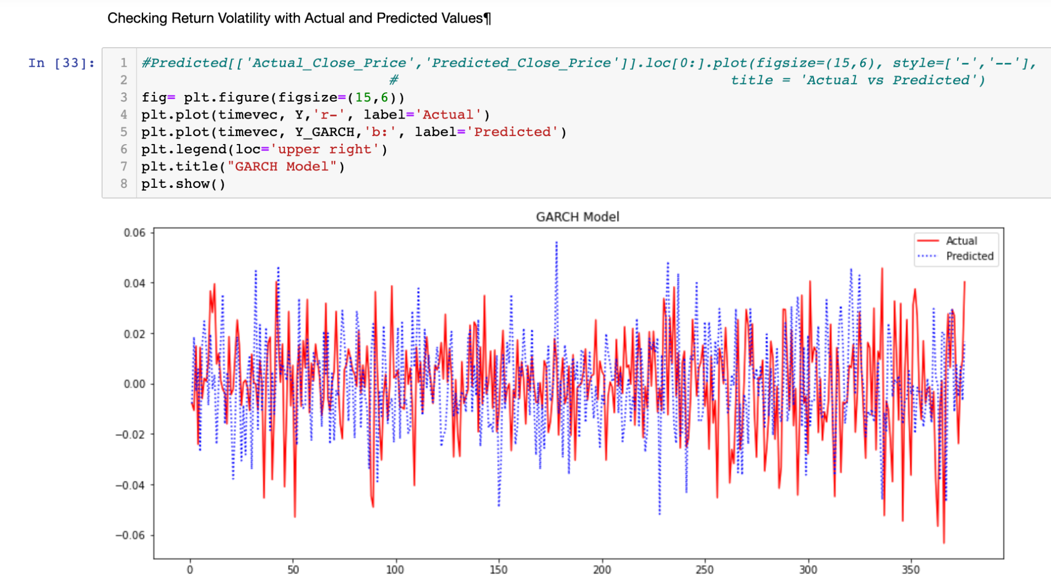
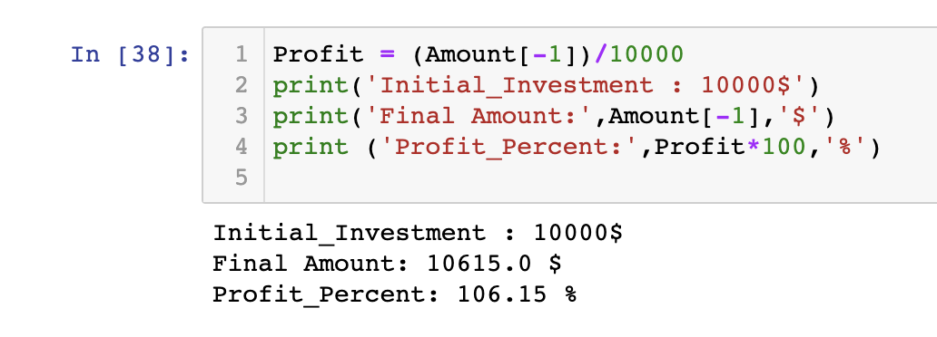
Checking
Return and volatility

Slide 23
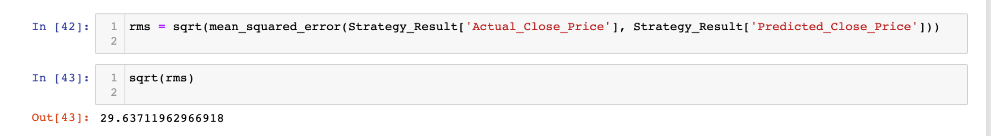
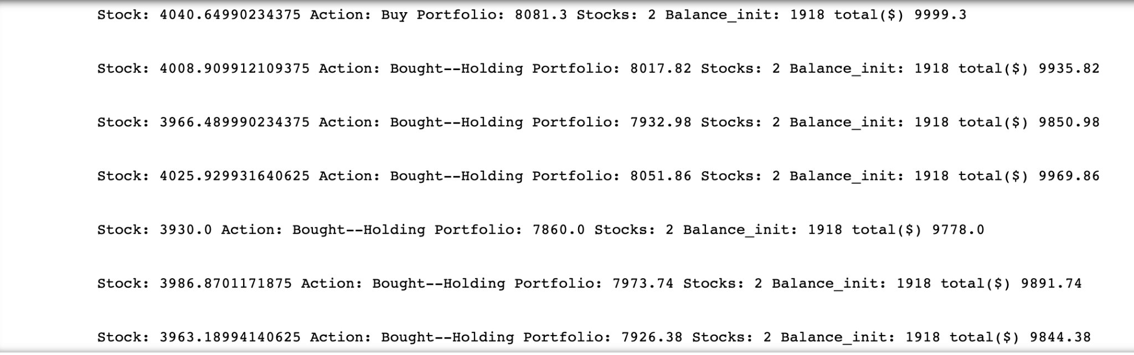
RMSE : 29
Trading Signal

Slide 24
4 Machine Learning Models

Slide 25
CANDIDATE MODELS
Auto Arima
XGBoost
LSTM
GARCH
KALMAN FILTER

Slide 26
AUTO ARIMA (AutoRegressive Integrated Moving Average)
Statistical analysis model that uses time-series data to better understand the data set or predict future trends.
Arima term into three terms, AR, I, MA:
p: the number of lag observations in the model; also known as the lag order.
d: the number of times that the raw observations are differenced; also known as the degree of differencing.
q: the size of the moving average window; also known as the order of the moving average.

Slide 27
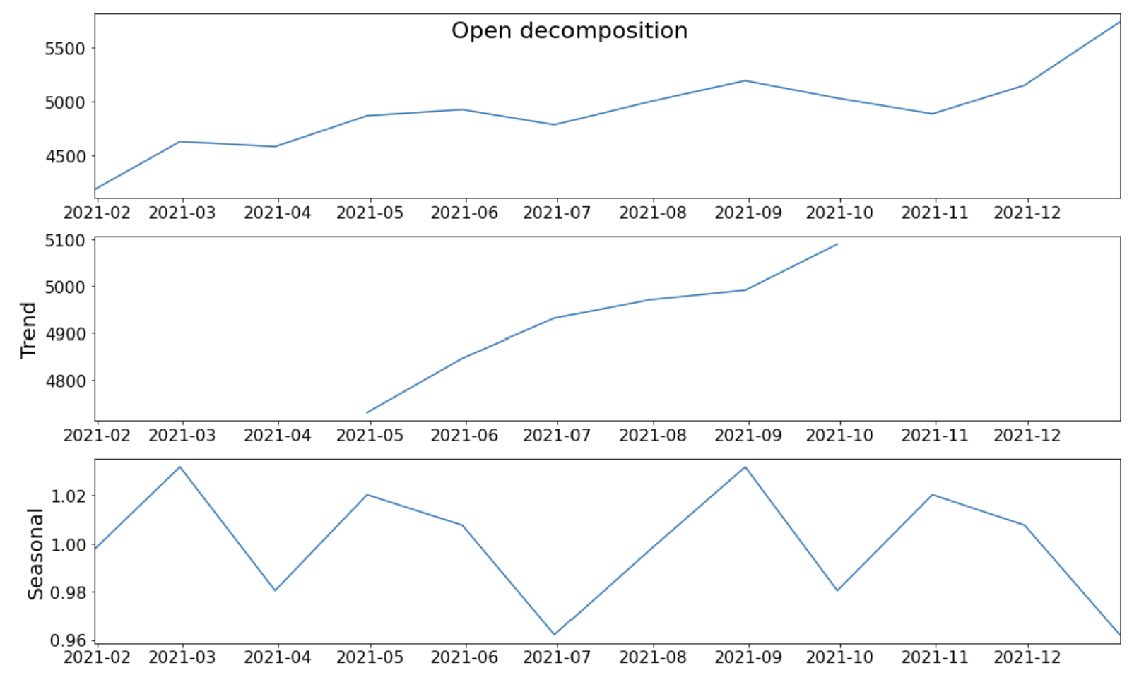
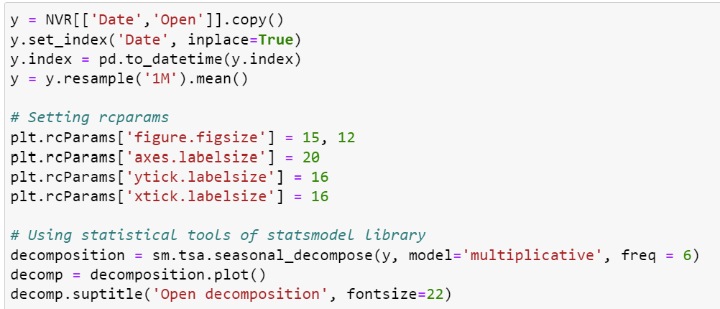
Decomposition-
Trend- Seasonal

Slide 28
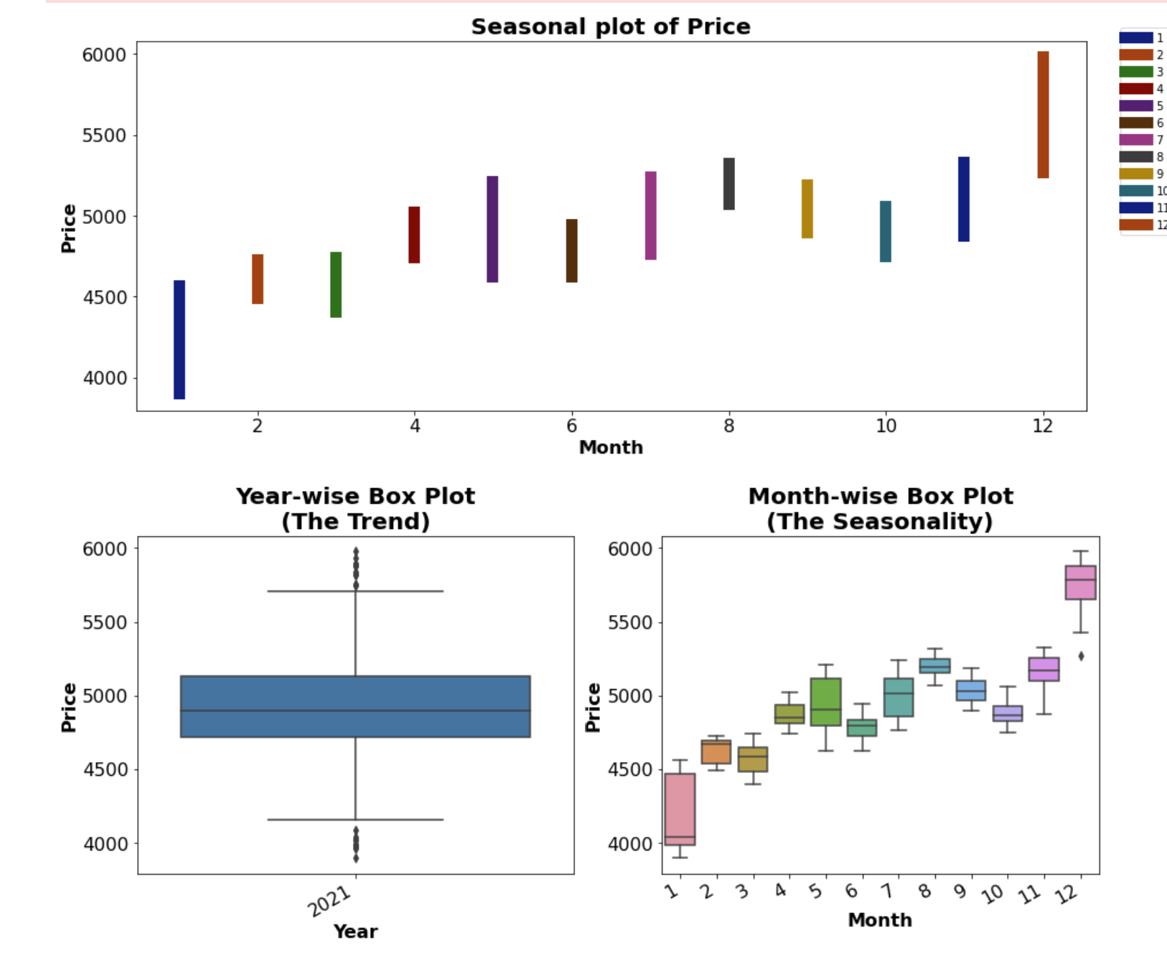
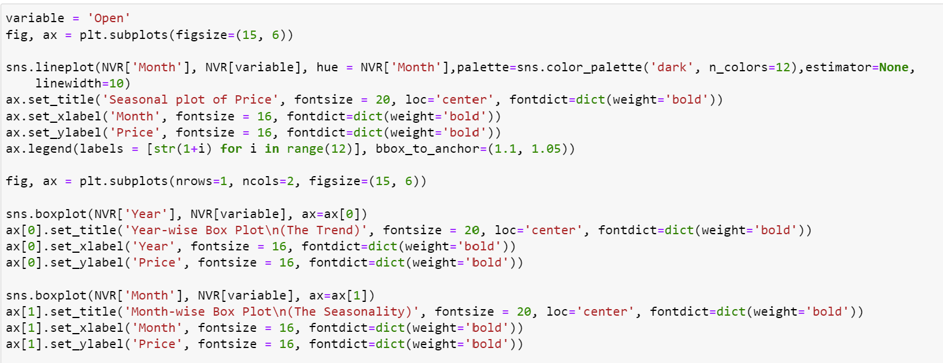
Seasonal -Box Plot- Month wise

Slide 29
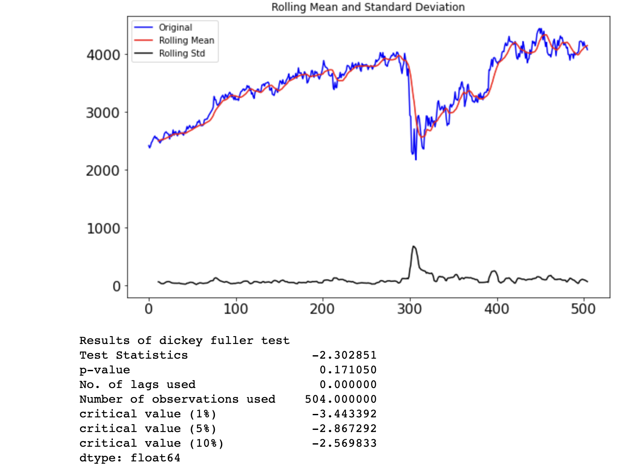
ADF (Augmented Dickey-Fuller) Test
One of the most widely used statistical tests is the Dickey-Fuller test. It can be used to determine whether or not a series has a unit root, and thus whether or not the series is stationary. This test’s null and alternative hypotheses are:
Null Hypothesis: The series has a unit root (value of a =1)
Alternate Hypothesis: The series has no unit root.
If the null hypothesis is not rejected, the series is said to be non-stationary. The series can be linear or difference stationary as a result of this.
The series becomes stationary if both the mean and standard deviation are flat lines (constant mean and constant variance).

Slide 30
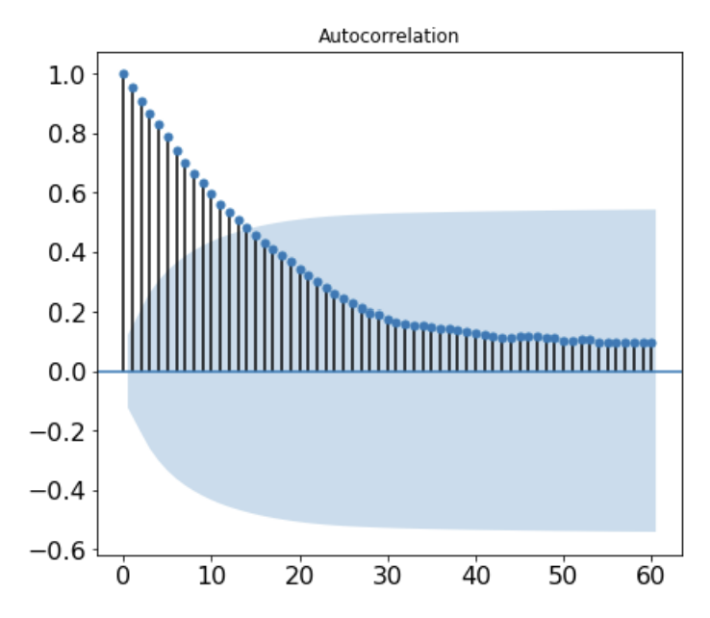
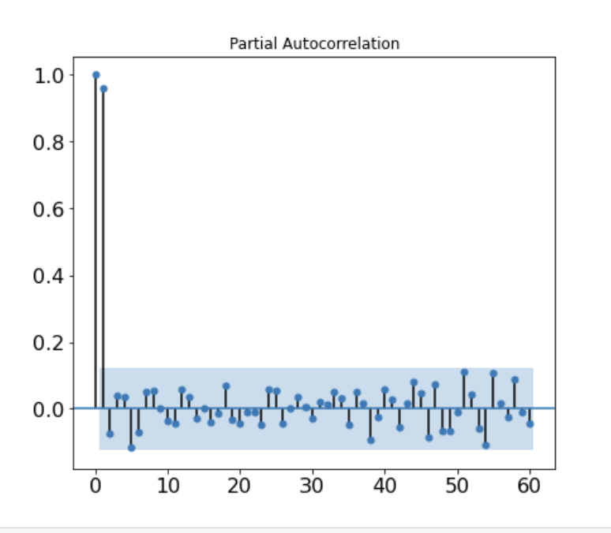
Autocorrelation - Partial Correlation

Slide 31
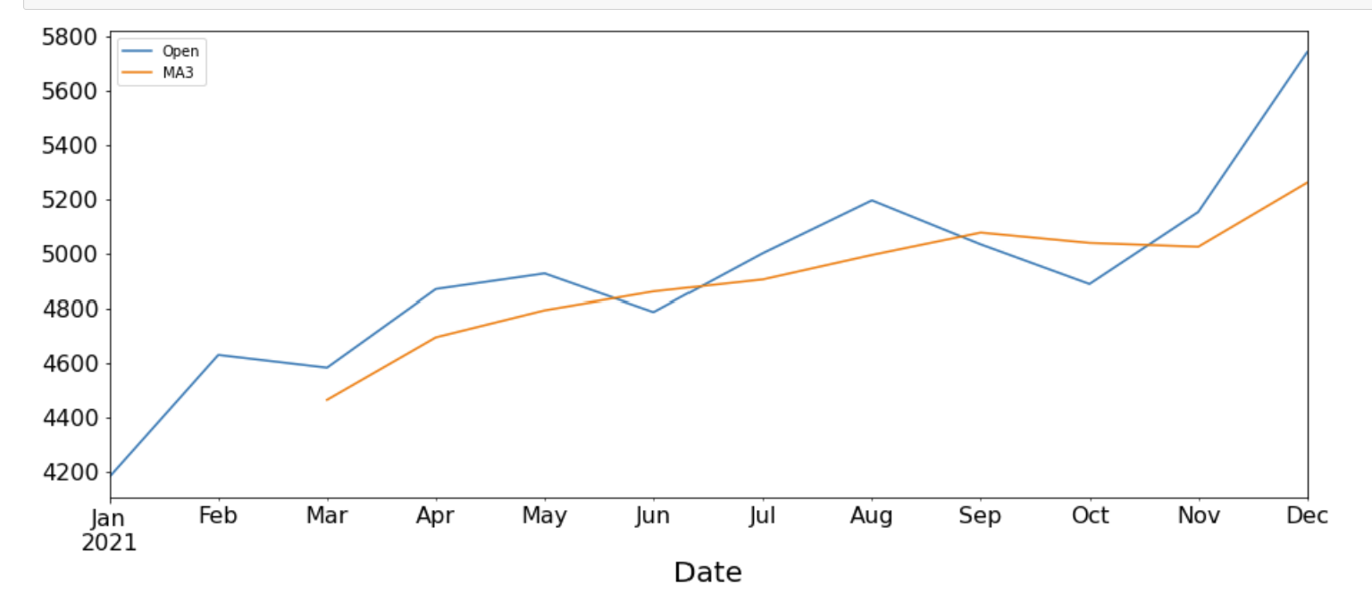
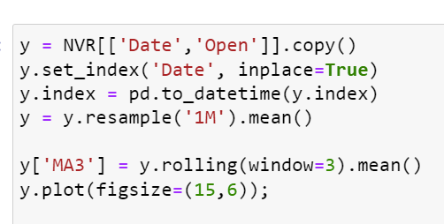
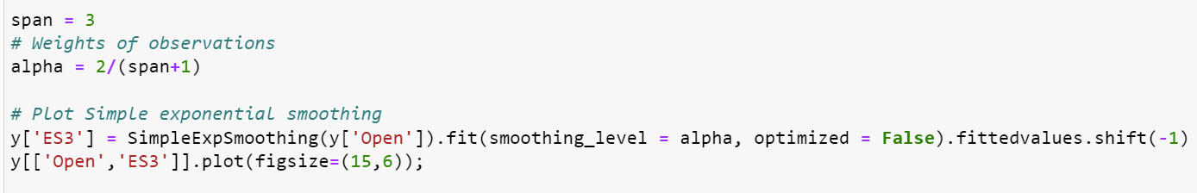
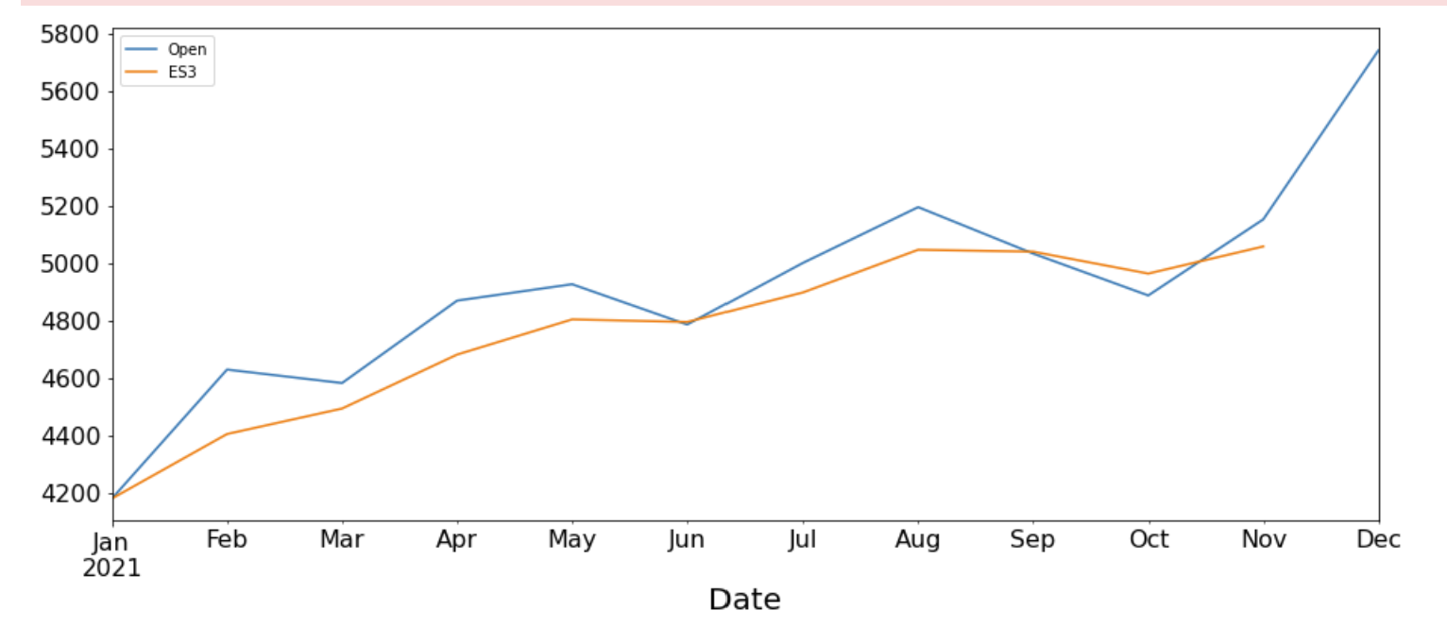
Moving Average Exponential Smoothing

Slide 32

Model Results

Slide 33


AUTO ARIMA SUMMARY RMSE: 412 Accuracy: 91.6%

Slide 34

XGBOOST (eXtreme Gradient Boosting)
Approach where new models are created that predict the residuals or errors of prior models and then added together to make the final prediction.
Preferred for structured or tabular datasets on classification and regression predictive modeling problems.
New models are added to correct the errors made by existing models.
Models are added sequentially until no further improvements can be made.

Slide 35




Slide 36

Adjusted Closing prices calculated

Slide 37

MODEL CREATION AND TRAINING

Slide 38


Consecutive tuning models

Slide 39



Final Model Results

Slide 40


XGBOOST SUMMARY
RSME on test set: 94.197
MSME on test set: 1.366 %

Slide 41

LSTM
Long Short Term Memory
Forgets data that is useless
Input Gate
Output Gate
Forget Gate

Slide 42


LSTM training data

Slide 43



LSTM Model training

Slide 44



LSTM test data and model evaluation

Slide 45







X:NVR+FRED+SPY

Slide 46
COMPARATIVE MODEL ANALYSIS
COMPARATIVE TECHNICAL ANALYSIS
MODEL | AUTO ARIMA | XGBOOST | LSTM
RMSE | 412 | 94.19 | 2.87
ALGORITHM | GARCH | KALMAN FILTER
RMSE | 29 | 0.17

Slide 47
5. 3MA/MACD/Trading signal

Slide 48


Double Moving Average Crossover Strategy
NVR closing price with moving average of 5 days and 20 days.

Slide 49


Double Moving Average Crossover Strategy
NVR closing price with moving average of 5 days and 20 days.

Slide 50

Three Moving Averages 10,50,200
Plotting the moving average of 10 days and 50 days of NVR adj close price history.
Indicating buy stock point if the moving average of 10 day is greater than moving average of 50 day.
Indicating sell stock point if the moving average of 10 day is lesser than moving average of 50 day.
Plotting a longer, 200 day moving average

Slide 51


Three Moving Averages 10,50,200

Slide 52





RSI (Relative Strength Indicator)
To observe the buying and selling trends of the stock
If RSI<20, stock is considered oversold
If RSI>80, stock is considered overbought

Slide 53



RSI (Relative Strength Indicator)
Looking at RSI during the 1 year period, we can see that the stock has been overbought (RSI > 80%) leading to uptrends

Slide 54



MACD (Moving Average Convergence Divergence)

Slide 55


MACD (Moving Average Convergence Divergence)

Slide 56




Portfolio

Slide 57



Portfolio

Slide 58
Conclusion
TRADING STRATEGY:
1 - LONG SHORT USING MACD FOR NVR (BUT KEEPING EYE ON RSI)

Slide 59

Conclusion
TRADING STRATEGY:
1 - LONG SHORT USING MACD FOR NVR (BUT KEEPING EYE ON RSI)
2 - BUY & HOLD FOR HOUSING PORTFOLIO (TO HAVE HOUSING AND NVR EXPOSURE)
Note: 2021 - good year for NVR and housing
2022 - Higher inflation, not good for housing, but NVR can take advantage using buybacks, and have less debt. Having exposure will be beneficial

